Slide 1
Chat GPT News Headline Sentiment Analysis
Susmitha Kusuma
Notes:
Sonali

Slide 2
Problem Statement
ChatGPT has been on the rise since its release on November 30th, 2022
Our goal is to:
Perform a sentiment analysis on news headlines about ChatGPT
Present visualizations that show trends/patterns derived from our sentiment analysis
Analyze how the sentiment of these headlines have changed over time since its launch
Analyze the breakdown of article sentiments (positive, neutral, negative) within each publishing company
Notes:
Sonali

Slide 3
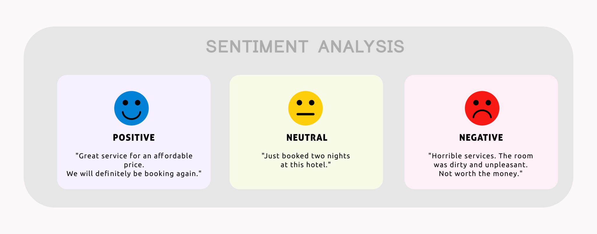
What is Sentiment Analysis?
Sentiment is an opinion of or attitude towards something which can be conveyed by words.
Sentiment analysis analyzes text to determine if its emotional tone is positive, neutral, or negative.
Notes:
Sonali

Slide 4
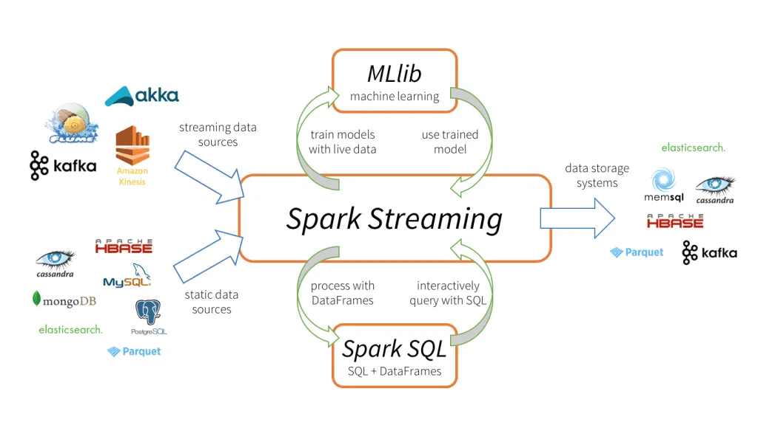
What is a Data Pipeline?
A method in which raw data is ingested from one or multiple data sources, processed, and then sent to a data storage system
Notes:
Damaris

Slide 5
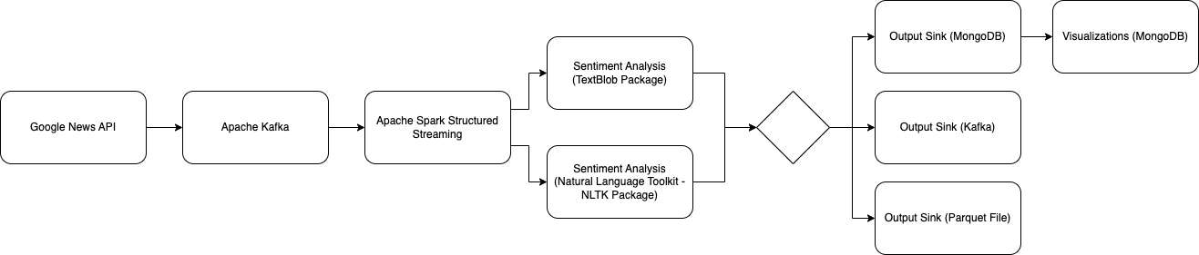
Our Data Pipeline - Tools and Technology
Fetch data (articles) using the GNews (Google News) Python API.
Send articles to Kafka for data ingestion.
Use Spark to read the data stream from Kafka and store it as a Spark Structured Streaming dataframe.
Perform sentiment analysis on Spark Structured Streaming dataframe using:
TextBlob and NLTK Library
Store data (articles with assigned sentiment) in output storage sinks.
MongoDB, Kafka, Parquet Files.
Create visualizations of data using MongoDB Atlas.
Notes:
Damaris

Slide 6
Why is this a Big Data project?
“What typically defines big data is the need for new techniques and tools in order to be able to process it. In order to use big data, you need programs which span multiple physical and/or virtual machines working together in concert in order to process all of the data in a reasonable span of time.”
- Professor Rodriguez, Lecture 1
Notes:
Sonali

Slide 7
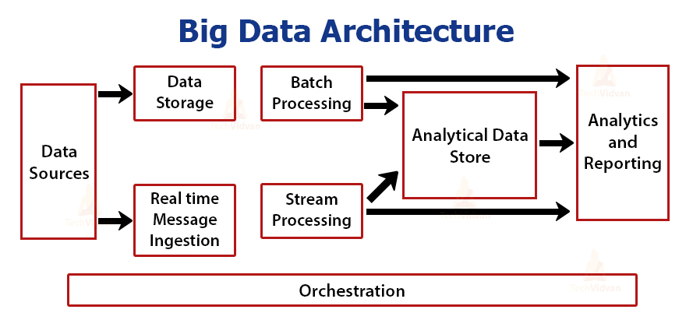
Why is this a Big Data project?
Big Data architectures have a number of layers or components. These are some of the most common that are in our project:
Data sources (GNews API)
Data storage / Analytical Data Store (MongoDB)
Real-time message ingestion (Kafka)
Stream processing (Spark)
Notes:
Sonali

Slide 8
GNews (Google News) Python API
In order to create an application generating events for Kafka, we used the GNews Python API
It fetches articles that contain the user-defined keyword (in our case “GPT”) from Google News
GNews retrieves a maximum of 100 articles per request
Sample JSON Response:
{'description': 'The Amazing Ways Duolingo Is Using AI And GPT-4 Forbes',
'published date': 'Fri, 28 Apr 2023 06:31:28 GMT',
'publisher': {'href': 'https://www.forbes.com', 'title': 'Forbes'},
'title': 'The Amazing Ways Duolingo Is Using AI And GPT-4 - Forbes',
'url': 'https://news.google.com/rss/articles/...'}
GNews allows users to specify the dates between which they want to retrieve articles
We retrieved ChatGPT related articles for each day of the 5-month period (November 30th, 2023 to April 30th, 2023).
After each query, the daily batch of articles was sent to Kafka
Notes:
Damaris

Slide 9
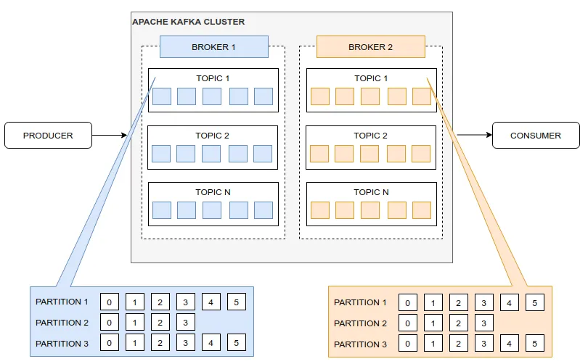
Apache Kafka
Apache Kafka is a distributed publish-subscribe messaging system
Broker: one of many servers running in a Kafka cluster
Topic: category to which records are stored and published
Divided into partitions that are split across brokers, allowing parallelization
Producer: sends each streaming event (batch of articles) to the topic
Establishes the connection with brokers
Consumer: retrieves each batch of articles to the topic
Notes:
Damaris

Slide 10
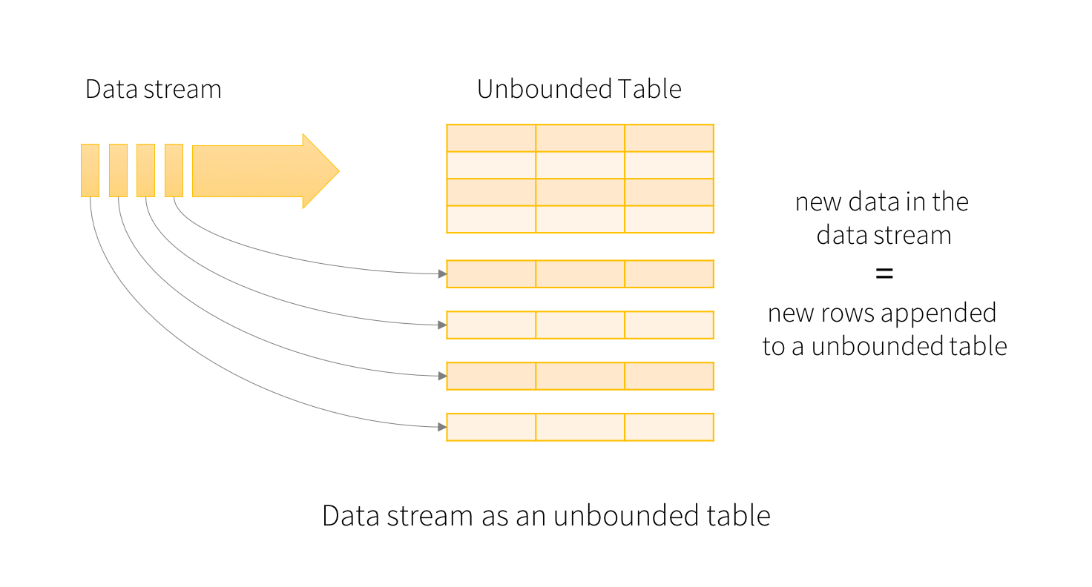
Apache Spark Structured Streaming
A scalable, fault-tolerant, low latency engine that processes streams of data
Spark reads the latest available data from the streaming data source (Kafka)
Processes it incrementally, updates result, and then discards the source data
Every data item (batch of articles) arriving in the stream acts like a new row being appended to the dataframe
Queries are processed using a micro-batch processing engine, which processes data streams as a series of small batch jobs
Notes:
Damaris

Slide 11
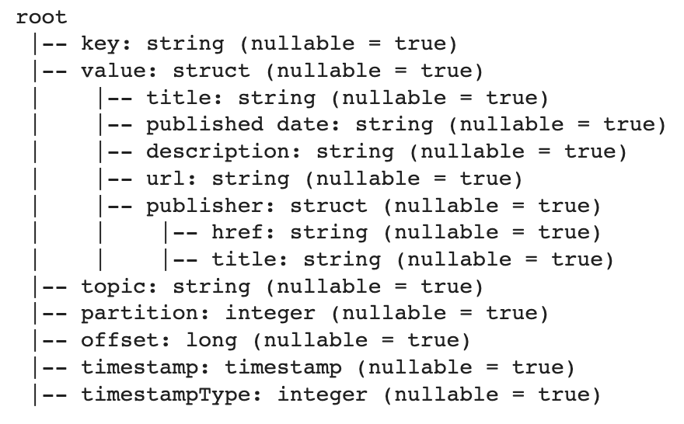
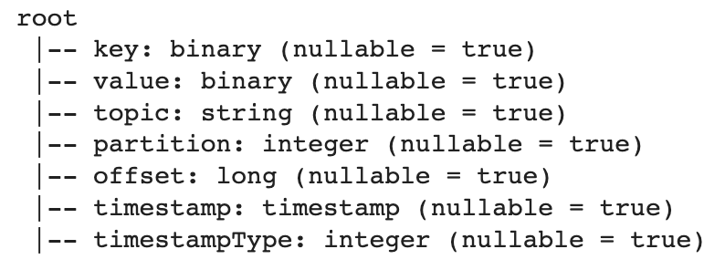
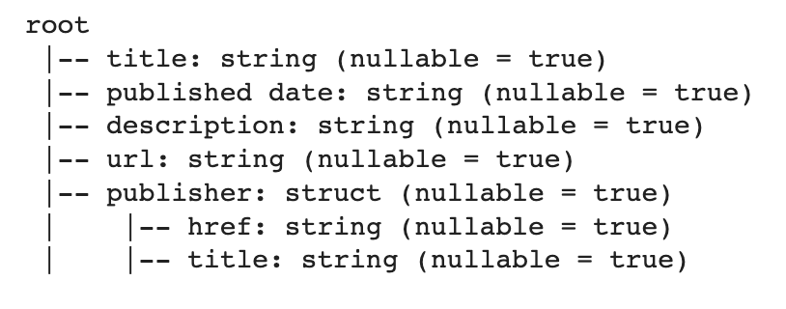
Apache Spark Data Processing
Read data stream (binary) from Kafka into a Spark Structured Streaming dataframe (string)
Unpack dataframe and remove Kafka attributes to prepare for sentiment analysis
Dataframe read from Kafka stream
Dataframe for Sentiment Analysis
Unpacked Dataframe
Notes:
Sonali

Slide 12
Sentiment Analysis - TextBlob and NLTK
The two most common approaches for performing sentiment analysis include using the TextBlob and NLTK Libraries
The TextBlob library has a property - sentiment - that returns a namedtuple of the form sentiment (polarity, subjectivity)
The NLTK SentimentIntensityAnalyzer calculates the polarity of the data
The polarity score for both libraries is a float within the range [-1.0, 1.0]
If the polarity is <0 the article sentiment is classified as “Negative”
If the polarity is ==0 the article sentiment is classified as “Neutral”
If the polarity is >0 the article sentiment is classified as “Positive”
The output of these sentiments are then sent to the output storage sink
Notes:
Sonali

Slide 13
Sentiment Analysis Sample: “Positive”
{_id: ObjectId('645cc3236a641949cfdbe749')
title: "ChatGPT-4: The Revolutionary AI That's 500x More Advanced Than ... - N…"
published date: "Sun, 08 Jan 2023 08:00:00 GMT"
description: "ChatGPT-4: The Revolutionary AI That's 500x More Advanced Than ... Ne…"
url: "https://news.google.com/rss/articles/CBMikAFodHRwczovL29yaWdpbmFsLm5ld…"
publisher: {href: "https://original.newsbreak.com", title: "NewsBreak Original"
processed_title: "chatgpt the revolutionary ai that s x more advanced than newsbre…"
subjectivity: 0.6166666746139526
polarity: 0.42500001192092896
sentiment: "Positive"}
Notes:
Sonali

Slide 14
Sentiment Analysis Sample: “Neutral”
{_id: ObjectId('645cc3236a641949cfdbe585')
title: "Meet GPT-JT, the Closest Open Source Alternative to GPT-3 - Analytics …"
published date: "Wed, 30 Nov 2022 08:00:00 GMT"
description: "Meet GPT-JT, the Closest Open Source Alternative to GPT-3 Analytics I…"
url: "https://news.google.com/rss/articles/CBMiV2h0dHBzOi8vYW5hbHl0aWNzaW5ka…"
publisher: {href: "https://analyticsindiamag.com", title: "Analytics India Magazine"}
processed_title: "meet gpt jt the closest open source alternative to gpt analytics i…"
subjectivity: 0.5
polarity: 0
sentiment: "Neutral"}
Notes:
Sonali

Slide 15
Sentiment Analysis Sample: “Negative”
_id: ObjectId('645cc3266a641949cfdbe78a')
title: "Educators concerned about students using artificial intelligence bots …"
published date: "Wed, 11 Jan 2023 08:00:00 GMT"
description: "Educators concerned about students using artificial intelligence bots …"
url: "https://news.google.com/rss/articles/CBMiiAFodHRwczovL3d3dy5raXJvNy5jb…"
publisher: {href: "https://www.kiro7.com", title: "KIRO Seattle"}
processed_title: "educators concerned about students using artificial intelligence bots …"
subjectivity: 1
polarity: -0.6000000238418579
sentiment: "Negative"
Notes:
Sonali

Slide 16
Output Storage Sinks - MongoDB, Kafka, and Parquet
We stored our output in 3 different storage sinks
MongoDB Atlas (Primary Output Sink)
A document-oriented NoSQL database used for high volume data storage
Kafka
Parquet Files
A column-oriented data file format that uses a data compression and encoding scheme for efficient data storage and retrieval
Not human readable
Notes:
Damaris

Slide 17
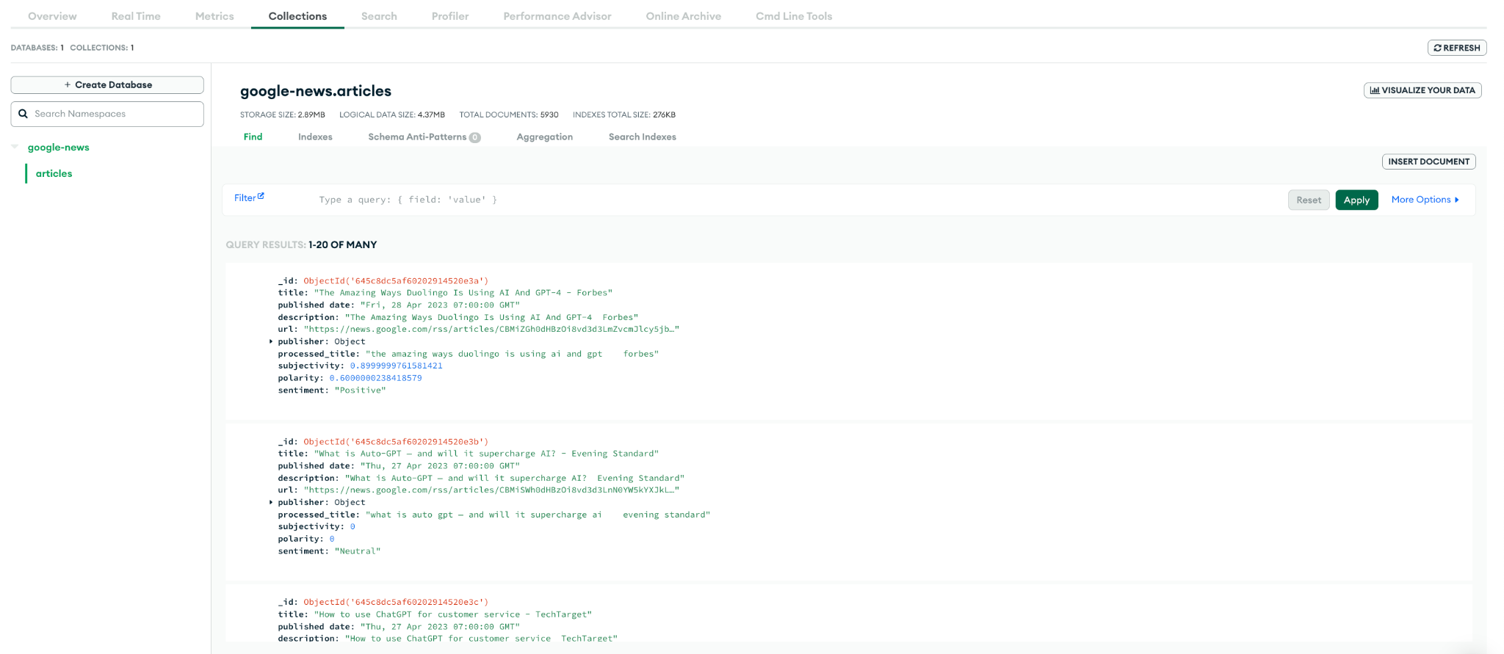
Output Storage Sink - MongoDB Atlas
Notes:
Damaris

Slide 18
Google (Colab)oratory
Google Colaboratory is a data analysis tool in the form of a python notebook that allows users to combine Python code, text, and images into a single executable document
Can be shared and edited by multiple people
Allows collaborators to easily establish the same python environment and work in one place
Notes:
Damaris

Slide 19
Visualizations (MongoDB Atlas)
Notes:
Susmitha

Slide 20
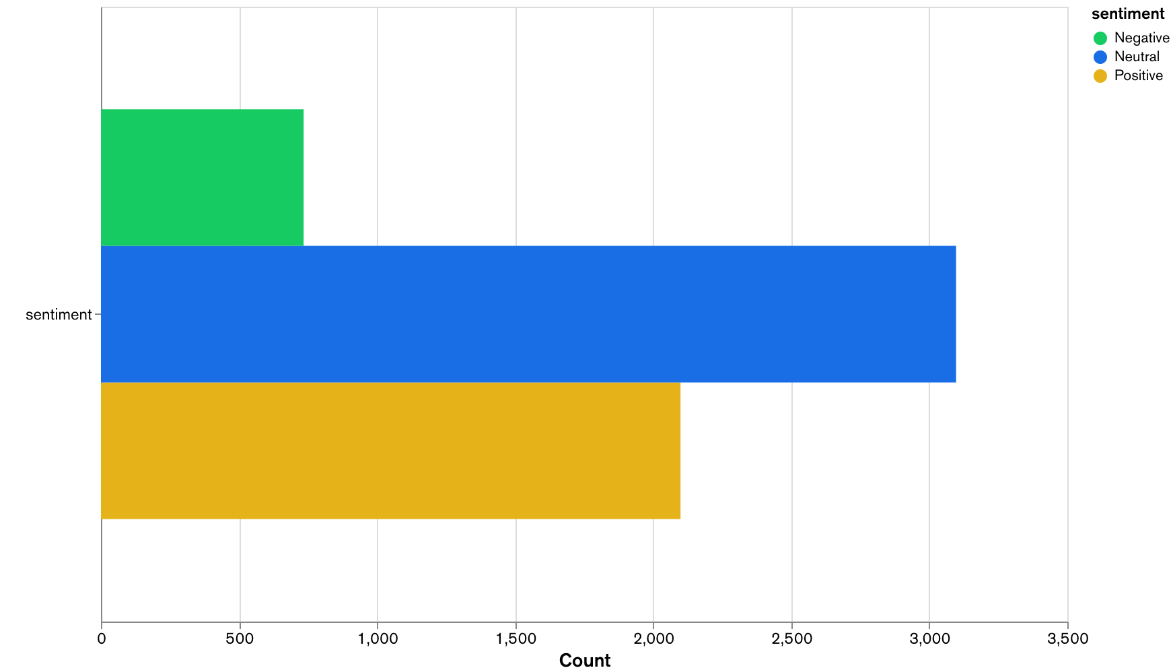
Overall Article Sentiment Distribution
Documents in collection: 5,930
Documents with “Positive” Sentiment: 2,099
Documents with “Neutral” Sentiment: 3,097
Documents with “Negative” Sentiment: 734
Notes:
Susmitha

Slide 21
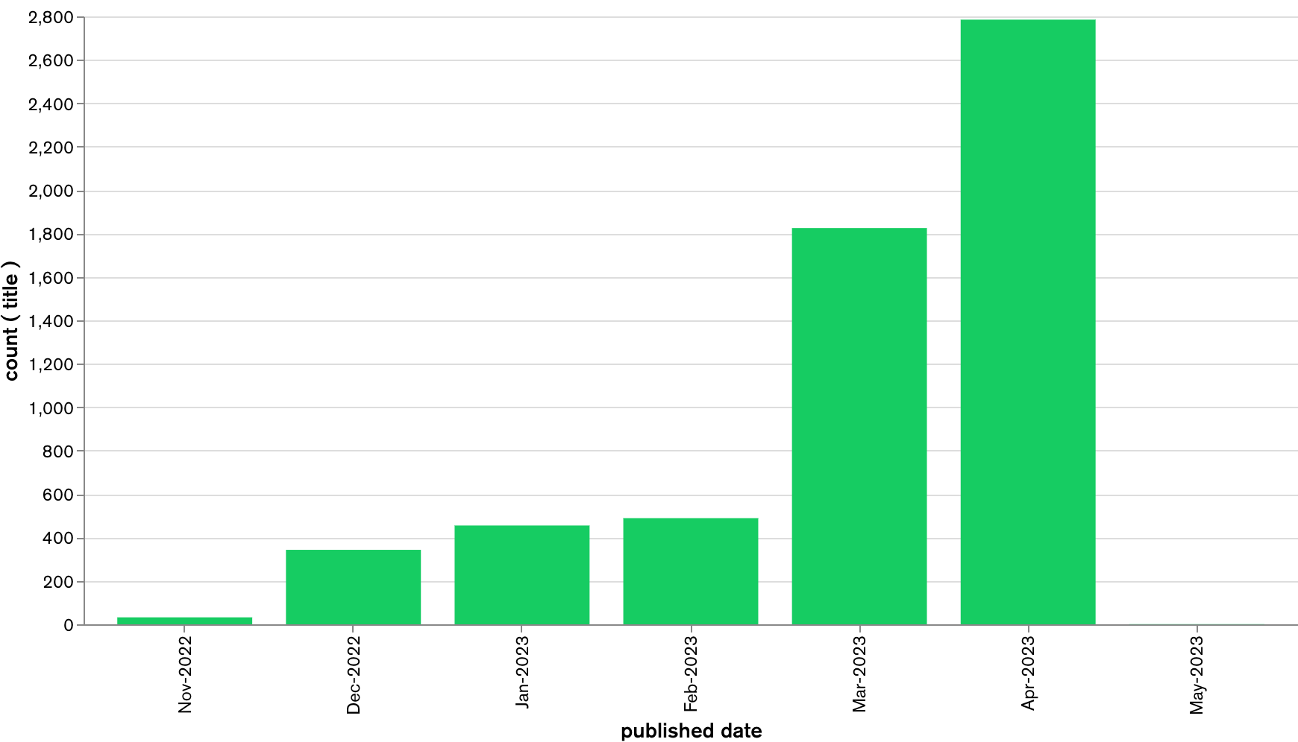
Monthly Article Publishing Distribution
Notes:
Susmitha

Slide 22
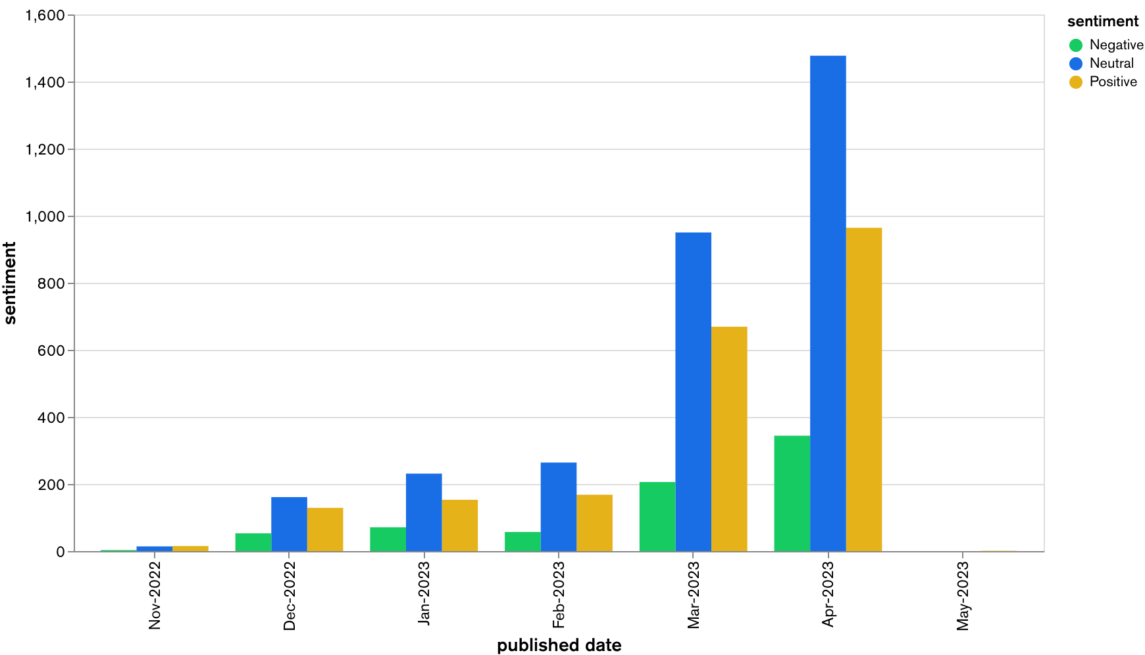
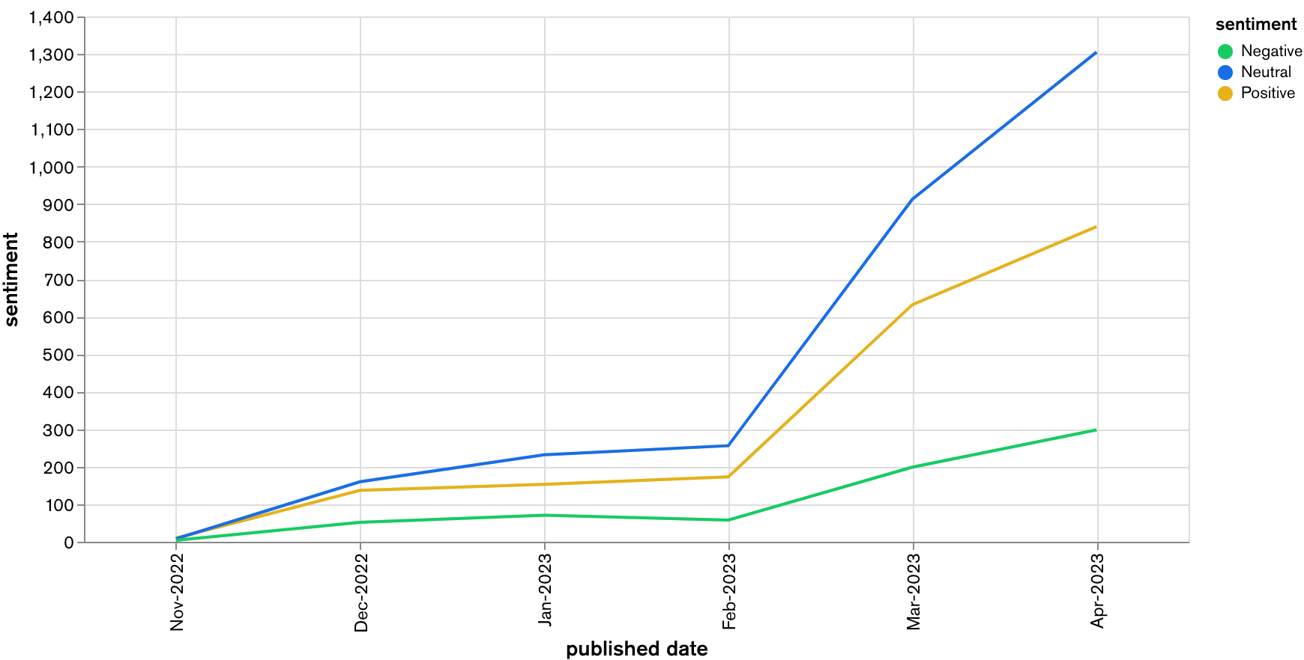
Monthly Article Sentiment Distribution
Notes:
Susmitha

Slide 23
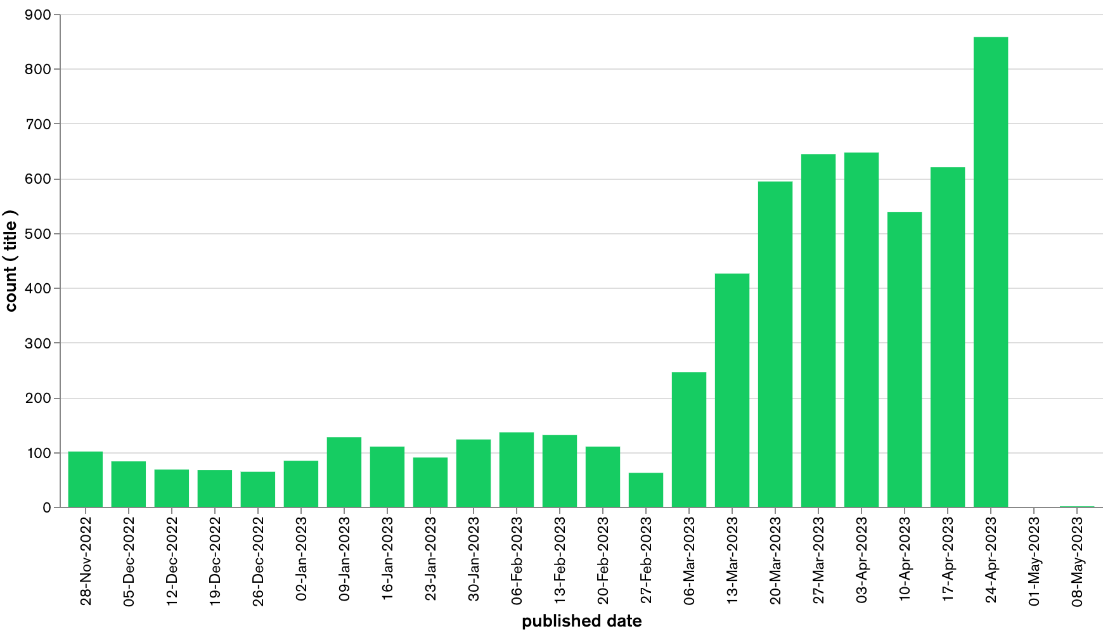
Weekly Article Publishing Distribution
Notes:
Susmitha

Slide 24
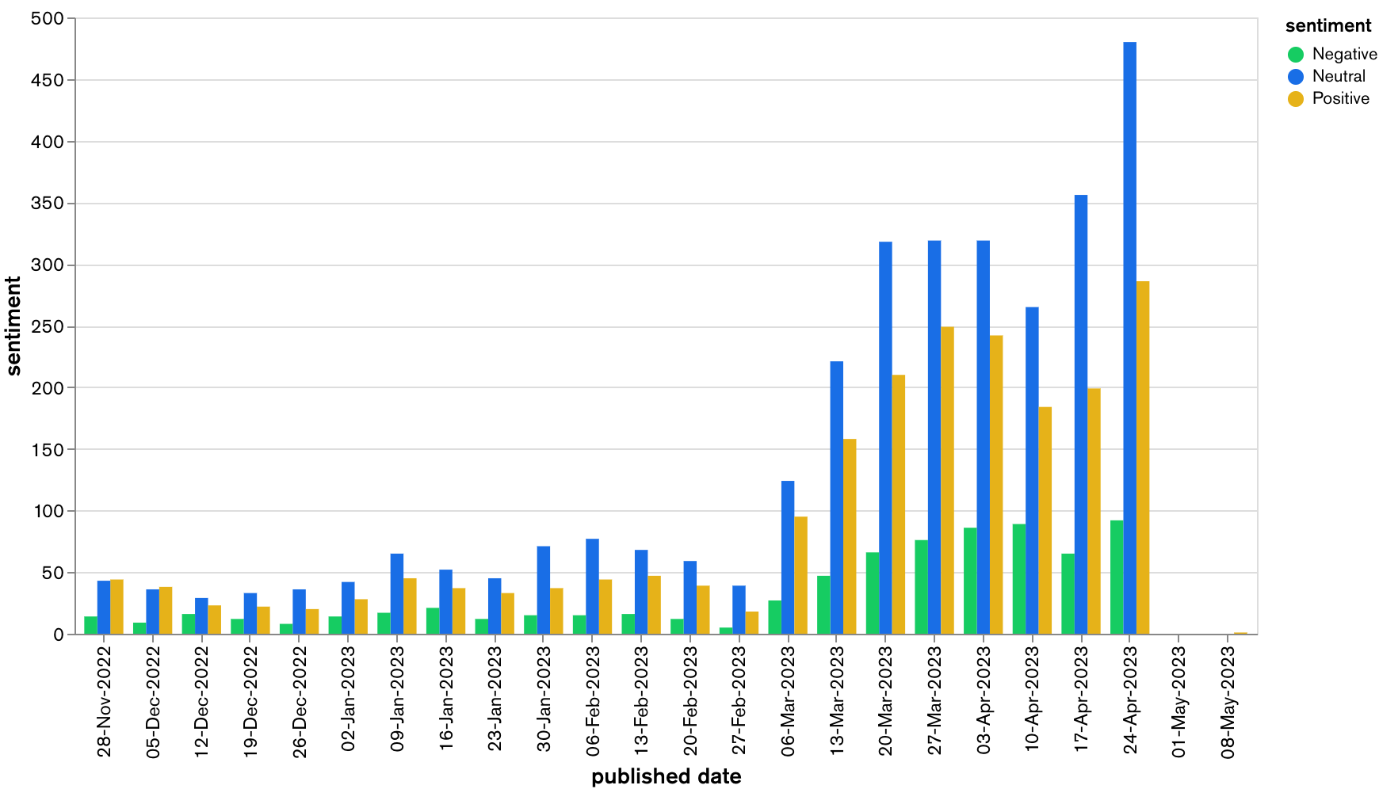
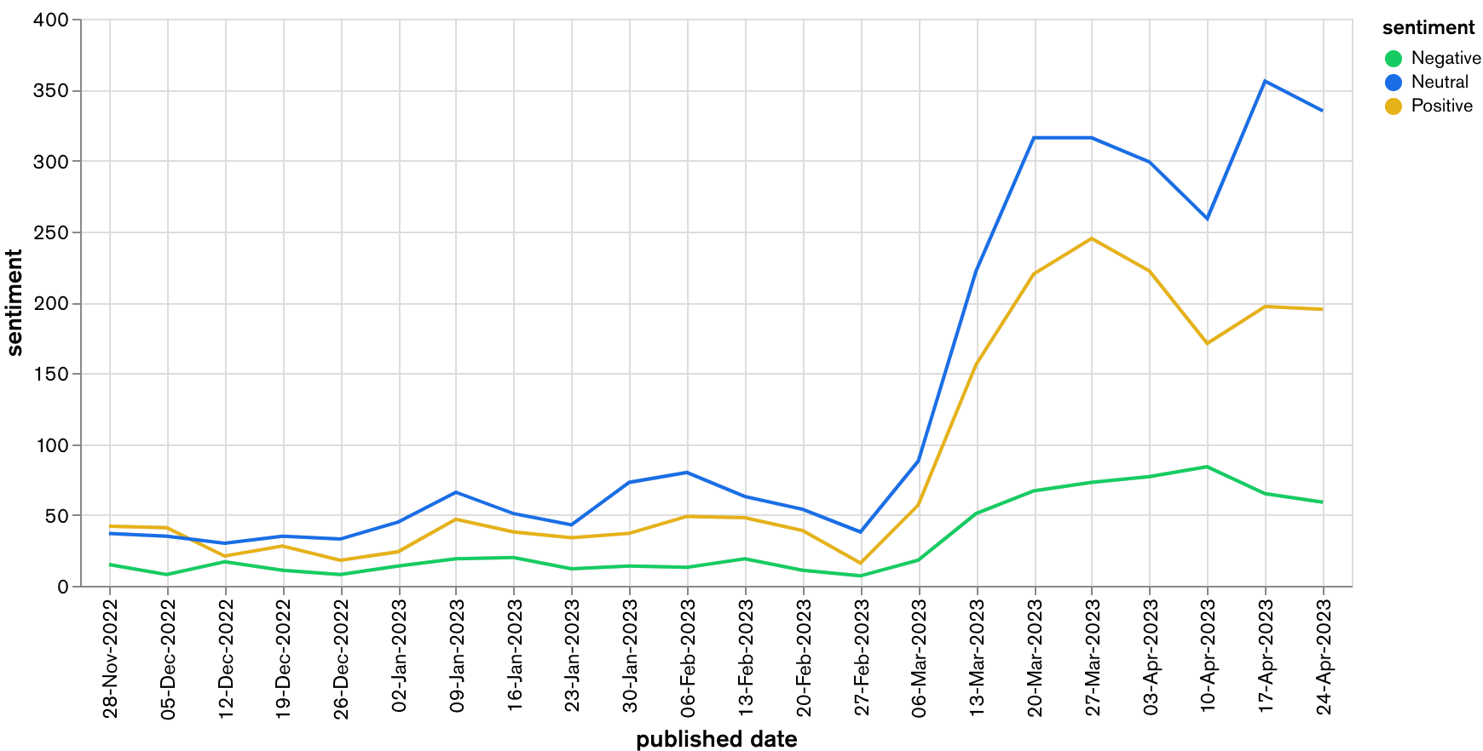
Weekly Article Sentiment Distribution
Notes:
Susmitha

Slide 25
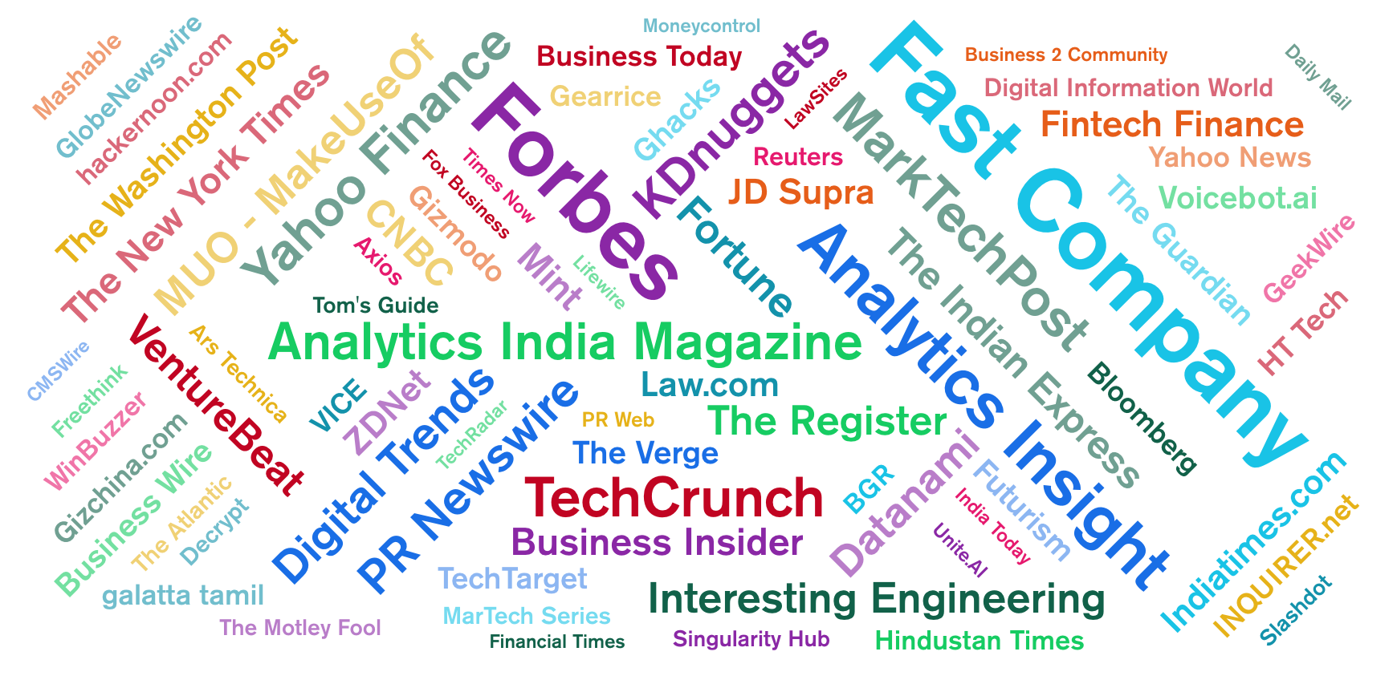
Most Frequent Publishers of ChatGPT Related Articles
Notes:
Susmitha

Slide 26
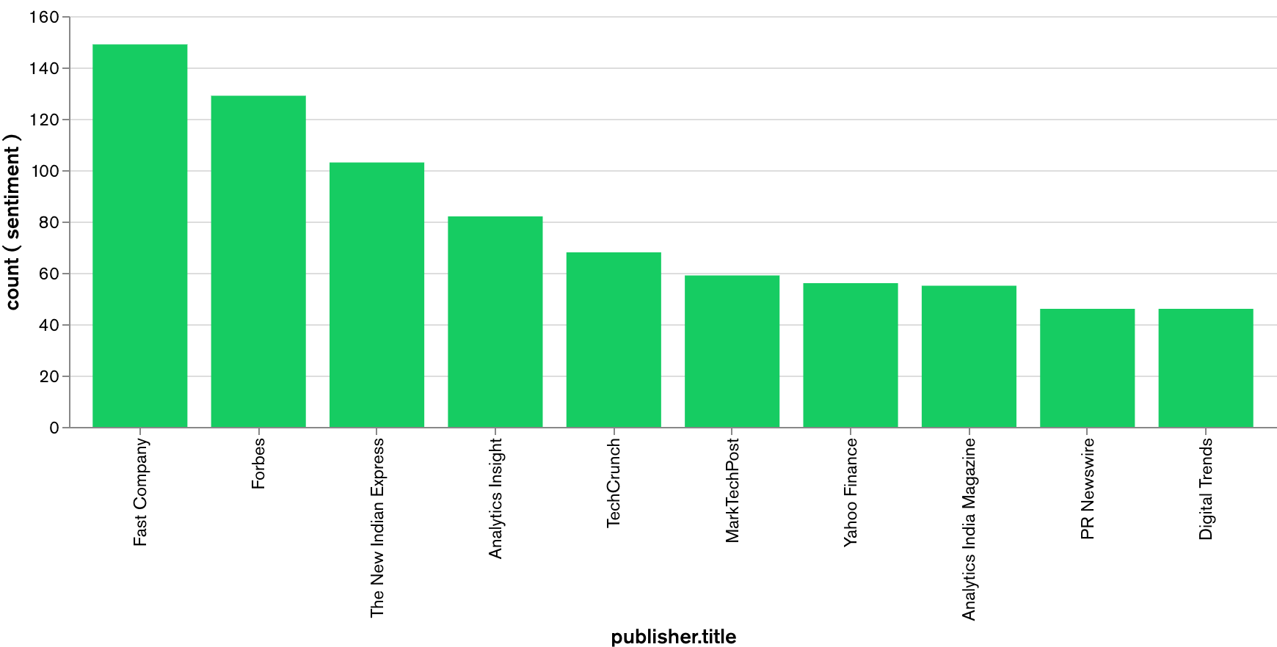
Most Frequent Publishers of ChatGPT Related Articles
Notes:
Susmitha

Slide 27
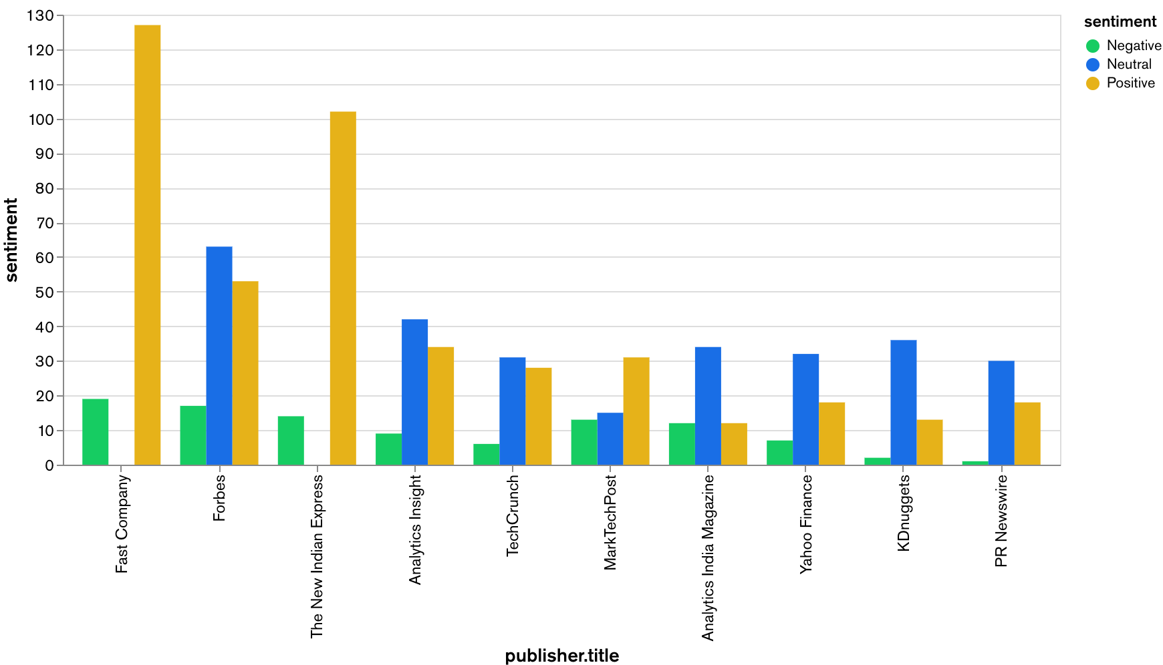
Sentiment Distribution of Most Frequent Publishers of ChatGPT Related Articles
Notes:
Susmitha

Slide 28
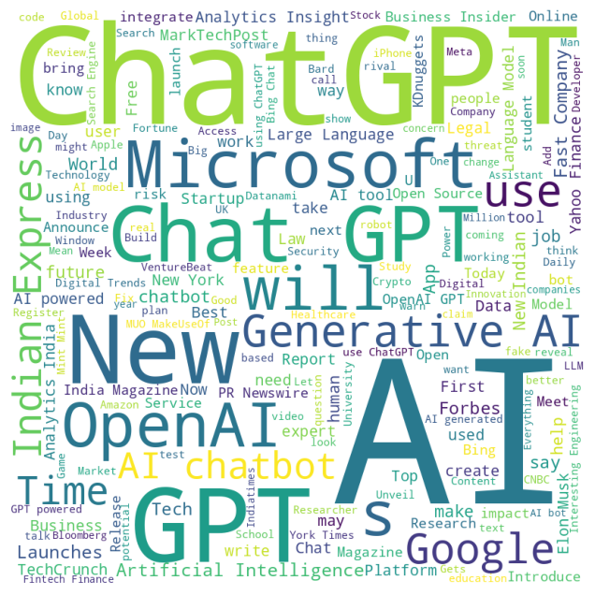
Most Common Words in ChatGPT Related Article Headlines
Notes:
Susmitha

Slide 29
Conclusion
ChatGPT article headlines are predominantly neutral
Business, Finance, and Tech companies are the top publishers of ChatGPT related articles
There has been a spike in the amount of ChatGPT related articles published in March and April of 2023
The ratio of negative to neutral to positive article sentiment has remained steady over time, despite the gradual increase in the number of articles published
Notes:
Susmitha

Slide 30
Thank You!
Notes:
Susmitha

